Slide 1
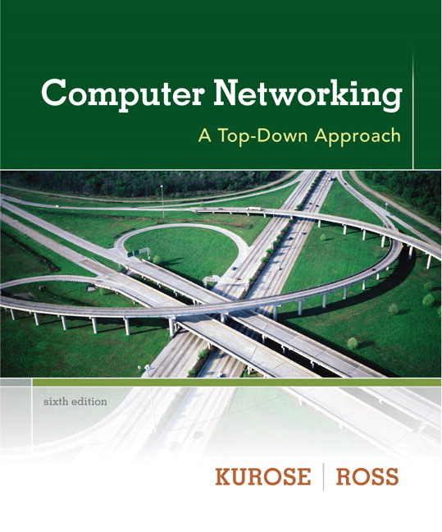

Chapter 8
Security
Computer Networking: A Top Down Approach
6th edition
Jim Kurose, Keith Ross
Addison-Wesley
March 2012
A note on the use of these ppt slides:
We’re making these slides freely available to all (faculty, students, readers). They’re in PowerPoint form so you see the animations; and can add, modify, and delete slides (including this one) and slide content to suit your needs. They obviously represent a lot of work on our part. In return for use, we only ask the following:
If you use these slides (e.g., in a class) that you mention their source (after all, we’d like people to use our book!)
If you post any slides on a www site, that you note that they are adapted from (or perhaps identical to) our slides, and note our copyright of this material.
Thanks and enjoy! JFK/KWR
All material copyright 1996-2012
J.F Kurose and K.W. Ross, All Rights Reserved

Slide 2
Simple encryption scheme
substitution cipher: substituting one thing for another
  monoalphabetic cipher: substitute one letter for another
plaintext: abcdefghijklmnopqrstuvwxyz
ciphertext: mnbvcxzasdfghjklpoiuytrewq
e.g.:
Plaintext: bob. i love you. alice
ciphertext: nkn. s gktc wky. mgsbc
Encryption key: mapping from set of 26 letters
to set of 26 letters

Slide 3
A more sophisticated encryption approach
n substitution ciphers, M₁,M₂,…,M_{n}
cycling pattern:
  e.g., n=4: M₁,M₃,M₄,M₃,M₂; M₁,M₃,M₄,M₃,M₂; ..
for each new plaintext symbol, use subsequent subsitution pattern in cyclic pattern
  dog: d from M₁, o from M₃, g from M₄
  Encryption key: n substitution ciphers, and cyclic pattern
  key need not be just n-bit pattern

Slide 4
Prototype function
From Kaufman
et al
64-bit input
8bits
8bits
8bits
8bits
8bits
8bits
8bits
8bits
S₁
S₂
S₃
S₄
S₅
S₆
S₇
S₈
8 bits
8 bits
8 bits
8 bits
8 bits
8 bits
8 bits
8 bits
8-bit to
8-bit
mapping
64-bit intermediate
Loop for
n rounds
64-bit output

Slide 5
Symmetric key crypto: DES
DES: Data Encryption Standard
US encryption standard [NIST 1993]
56-bit symmetric key, 64-bit plaintext input
block cipher with cipher block chaining
how secure is DES?
  DES Challenge: 56-bit-key-encrypted phrase decrypted (brute force) in less than a day
  no known good analytic attack
making DES more secure:
  3DES: encrypt 3 times with 3 different keys

Slide 6
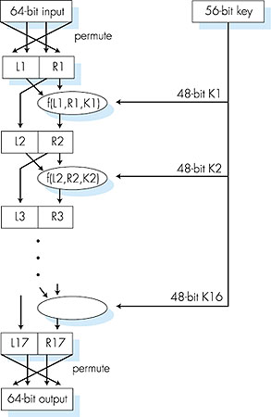
Symmetric key crypto: DES
DES operation
initial permutation
16 identical “rounds” of function application, each using different 48 bits of key
final permutation

Slide 7
AES: Advanced Encryption Standard
symmetric-key NIST standard, replacied DES (Nov 2001)
processes data in 128 bit blocks
128, 192, or 256 bit keys
brute force decryption (try each key) taking 1 sec on DES, takes 149 trillion years for AES

Slide 8
AES: Advanced Encryption Standard
symmetric-key NIST standard, replacied DES (Nov 2001)
processes data in 128 bit blocks
128, 192, or 256 bit keys
brute force decryption (try each key) taking 1 sec on DES, takes 149 trillion years for AES

